Slide 1
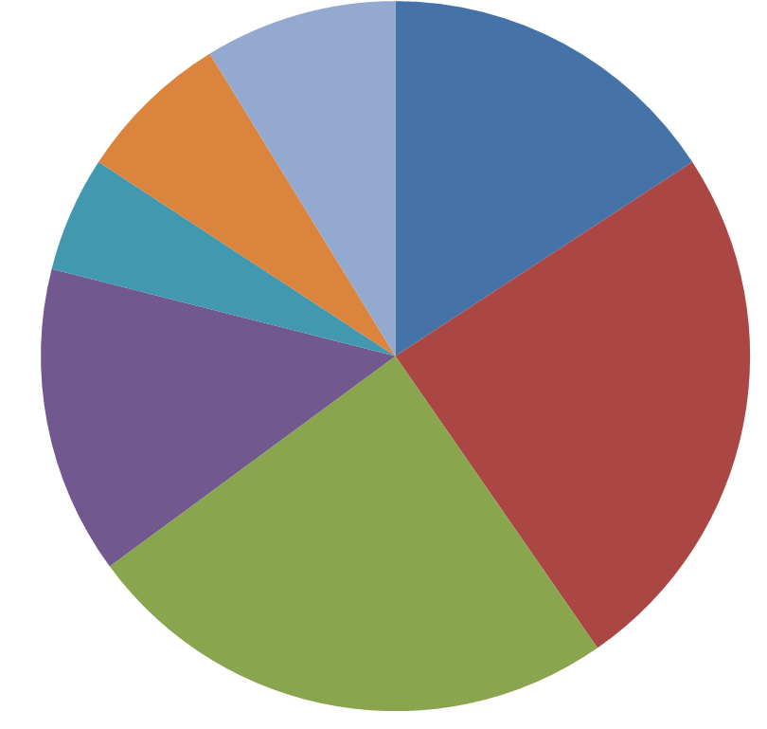
Trade Compliance Responsibilities
Finance,
Tax & IT
Sales & Marketing,
Engineering
Engineering
Technical Specs
Design Intent
R&D
End Use
Prototypes
Samples
Finance/Tax
Invoicing
Records
Cost
Royalties
License Fees
Transfer Pricing
Valuation
Adjustments
Human
Resources
Sales & Marketing
Pricing
Rebates
Discounts
End User Info
Promotions
Samples
After Sales Support
Returns
Customer Service
Order Entry
Visa Status
Nationalities
Denied Parties
Value
End Use
End User
Destination
Preferential Treatment
Quantity
License
Origin
Legal & Trade
Compliance
Oversight
Special Programs
Classification
Certificates for Origin
Logistics
Inco-terms
Goods Movements
Tone
Control
Support
Objectives
Resources
Risk Assessment
Sourcing
MSAs
Pricing
Executive
Shipping & Receiving
Marking
Quantities
Customs Brokers
Data
Records
Admin Present.
Purchasing
Suppliers
Records
Suppliers
Invoice
Origin
Security
Manufacturing
Raw Materials
Indirect Materials
Machinery & Equip
Sub-components
Origin
Assists
Operations
Carriers & Agents
Shipping Docs
Security
Commissions
External
Trade Compliance Encompasses All Functions

