Slide 1
Global Trade Management Review
June 2014

Slide 2
Best Practice Research
International Trade can be divided into four areas:
  GTM (Global Trade Management) – Compliance and Logistics
  Technology
  Measurements & Metrics
  Organization
Four stages for improvement:
  Stage 1: Market Focused
  Stage 2: Cost Focused
  Stage 3: Demand Driven
  Stage 4: Value Driven
Notes:
Bar graph – where COMPANY pays freight & has risk; does not include exports or importers where all transportation & custom clearance services are provided by the customer (ex) or seller (imp)
2013: top 100 importers in the US max 731,500 TEU min 15,100 TEU
2013: top 100 exporters in the US max 374,200 TEU min 13,500 TEU

Slide 3
2013 Exports by Country
Notes:
Not able to obtain import volumes from SAP; this information needs to be provided by each region’s logistic manager / customs broker

Slide 4
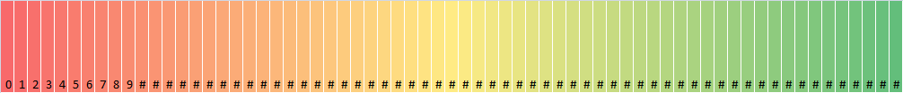
Global Trade Management – Compliance and Logistics
Laggards
Average
Best in Class
Complete reliance on broker and/or forwarder
Decentralized separate groups by role and geography
Manual document creation and transfer
Manual visibility through carriers/third parties
Regulatory compliance not a priority
Centralized function, with global and regional contracts
Reduce total dependency on third-party management
Automated document creation
Integrated door-to-door planning and execution
Landed cost considerations
Automate compliance functions
Closely integrated sourcing and logistics
C-TPAT and other certifications
Global, centralized oversight
Cost to serve understood at the product family and customer segment level
Logistics, compliance, finance, third-party logistics and sourcing collaborate to make decisions based on creating customer value
Compliance mandates analyzed for current and future opportunities for savings, as well as to reduce risk
Education and training program

Slide 5
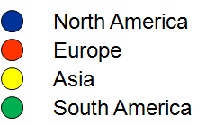
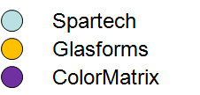
Compliance and Logistics
Q1 2013
Laggards
Best In Class
Projects / Improvements:
Centralized by region
NA: Education, training and documented job aids (ex: NAFTA, IncoTerms)
Corporate Level Supplier Relationship Management
Annualized forecasted benefits: $583K; 2014 YTD realized: $172K
Risks and Opportunities:
Decentralized by region and BU with disparate processes
No control, visibility, accountability or strategy
Complete reliance on 3rd parties with minimal ability to evaluate performance
Q2 2014
Laggards
Best In Class
Risks and Opportunities:
Independent by region, no best practice sharing
Compliance treated as separate process from logistics; reactive
Few metrics to evaluate compliance globally and by region
Projects / Improvements:
Global, centralized management with appropriate staffing and high performing suppliers
Emphasis on meeting customer requested service levels
Integrate compliance as part of daily operations to minimize risk (reclassification, regulations)
DSS
2015: Targeted improvement
Laggards
Best In Class
Notes:
Evolving –best in class criteria expected to change over next few years for GTM
Project # 2013-148, 2013-149, 2013-161, 2013-162, 2013-163, 2013-164, 2013-181

Slide 6
Global Trade Management – Technology
Laggards
Average
Best in Class
Manual; paper based
Separate legacy systems
Reliance on broker and 3PL technology
Difficult to extract accurate, historical spending data and perfect order measurements
Master data inaccuracies
Standardized, automated technology by function or region
Electronic data interchange (EDI) adoption
ERP integration master data management and operational interfaces with sales and purchase orders
Adoption of basic reporting and analytics tools
Web-based, real time collaboration platform used by all parties in the supply chain
Flexible, adaptive, risk responsive systems
Impact of decisions available in near real time
Technology supports end customer goals
Advanced, specialized analytics tools
Use of provider / supplier collaboration portals
Visibility, collaboration and planning tools involved

Slide 7
Technology
Q1 2013
Laggards
Best In Class
Risks and Opportunities:
Separate legacy systems in use
Difficult to extract historical data
No metrics or reporting; inaccurate data
Dependent of 3rd party’s technology, which has varying levels of sophistication
Projects / Improvements:
By region, standardized 3rd party suppliers
NA -
  Close to real time data, analytics and reporting capabilities, web portals that can be accessed by COMPANY or our customers
  Elimination of manual processes, standardization of technology and processes
SAP queries created for internal reporting
Q2 2014
Laggards
Best In Class
Risks and Opportunities:
Multiple 3rd party technology platforms by region
Reporting differences across regions
Limited global visibility on shipment data stored by 3rd parties
Projects / Improvements:
Fully integrate DSS, Glasforms, and ColorMatrix into NA GTM program
Globally standardize 3rd party technology and analytics capabilities
Implement visibility, collaboration and planning tools
2015: Targeted improvement
Laggards
Best In Class

Slide 8
Global Trade Management – Measurements & Metrics
Laggards
Average
Best in Class
Measurements & metrics siloed by role, BU and / or geography
Historical or current costs
Little or no auditing / oversight
No connection to customer outcomes, risk supply
Heavy reliance on 3rd parties
Freight costs and associated fees
Taxes and duties
On time ship
Total landed cost
Beginning measurement of 3rd parties
Analysis of regional trade agreements
Analysis of product classifications
Integrated analytics
Logistics and compliance measurements tied directly to customer service measurements and corporate financials
Total delivered cost
3rd party cost auditing and collaboration towards resolution
Supplier / vendor performance analytics

Slide 9
Measurements & Metrics
Q1 2013
Laggards
Best In Class
Risks and Opportunities:
100% reliant on 3rd parties for performance measurements
Lack of analytics and standardized reporting globally or stratified by region, BU
Projects / Improvements:
Internal measures: established KPIs and baseline performance
External measures: SRM adoption
Q2 2014
Laggards
Best In Class
Risks and Opportunities:
Separate KPIs and reporting by region
Lagging metrics
Few established BU performance targets
Projects / Improvements:
Global performance dashboard; targets by region & BU
Global SRM adoption
Ability to forecast performance to assist commercial team and proactively avoid / mitigate issues
Advanced measurements (ex: global classification discrepancies)
2015: Targeted improvement
Laggards
Best In Class

Slide 10
Global Trade Management – Organization
Laggards
Average
Best in Class
Stand alone departments
Functional independence
No specialized staff
No growth programs, limited training
No alignment to business objectives
Development of internal metrics and systems
Standardization of regional processes
Leadership established over cross-functional processes
Global, centralized functions
Well managed relationships with 3rd parties
Organization pursuing collaborative opportunities with suppliers and customers
Incentives tied to overall business objectives
Cross functional group advising on logistics, compliance, sourcing and customer service issues
Organization viewed as strategic differentiator
Team of highly specialized logistics and compliance professionals
Continuous improvement culture
Tightly integrated into technology and innovation activities

Slide 11
Organization
Q1 2013
Laggards
Best In Class
Risks and Opportunities:
Lack of support from Corporate Logistics; each BU is self-reliant
No cross-functional communication
No internal metrics or standardized processes
Compliance partner providing logistics services, non core competency
Projects / Improvements:
NA: Designed and implemented Global Trade Management (GTM) area; added 1 FTE
SA and Asia centralizing GTM
Partnered with customer service to streamline processes and focus on customer needs
Corporate logistics owns supplier relationship management (SRM)
Continuous improvement culture
Q2 2014
Laggards
Best In Class
Risks and Opportunities:
Regionally focused global logistics leadership and strategy (NA, Mexico, China, etc)
Minimal cross functional integration; reactive only
Solutions identified reactively
Projects / Improvements:
Globally focused logistics team and strategy; best practice sharing
Senior mgmt. led committee overseeing GTM’s cross functional partnering with sourcing, finance, product stewardship, legal and commercial
Support commercial team by making GTM a strategic differentiator
2015: Targeted improvement
Laggards
Best In Class
Notes:
Color
Move to end

Slide 12
Appendix

Slide 13
References
Gartner
Journal of Commerce (JOC)
American Shipper
Trade Beam, Stanford University
Council of Supply Chain Management Professionals (CSCMP)

Slide 14
Appendix: Scoring Methodology

Slide 15
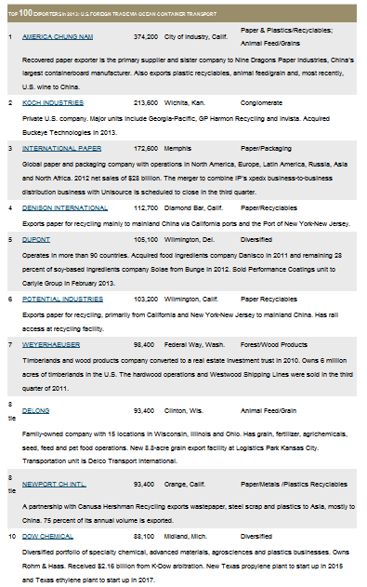
Top 10 Exporters in US

Slide 16
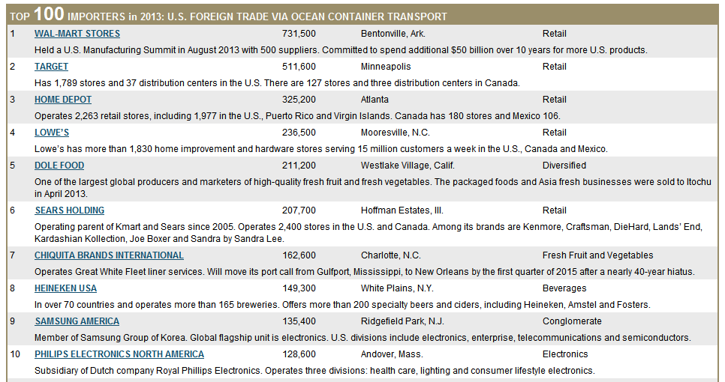
Top 10 Importers in US

Slide 17
TEU Definition

Slide 18
2013 Volumes – Shipping Condition 51
** Note: Removed US21 from data; SR 2014 volume was 444 TEU, 4M KG
Notes:
A TEU can hold up to 47,000 lbs. COMPANY’s freight will cube out before it weighs out. Rough average of 20,000 lb per 1 20’

