Slide 1
Global Trade Management (GTM)
Best Practices and Benchmarking
United States and Canada

Slide 2
Overview
What is Global Trade Management?
“This is the practice of streamlining the entire life cycle of global trade across order, logistics, compliance, and settlement activities to significantly improve operating efficiencies and cash flow, while reducing risk. GTM includes, but is not limited to, trade compliance, visibility to shipments, total landed cost, trade security, and trade finance.” (ref. #1)

Slide 3
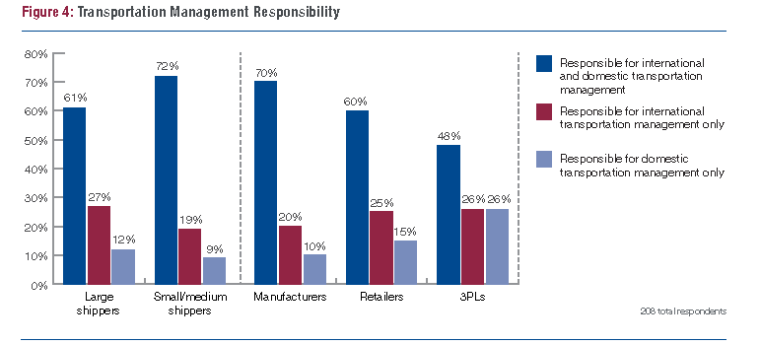
Organizational Structure
Best Practices / Benchmarking
COMPANY
No one size fits all best practice; depends on size of company, strategy, and global trade profile
Separation of duties between domestic and global transportation management
(ref. #4)
Action required by COMPANY to close the gaps?

Slide 4

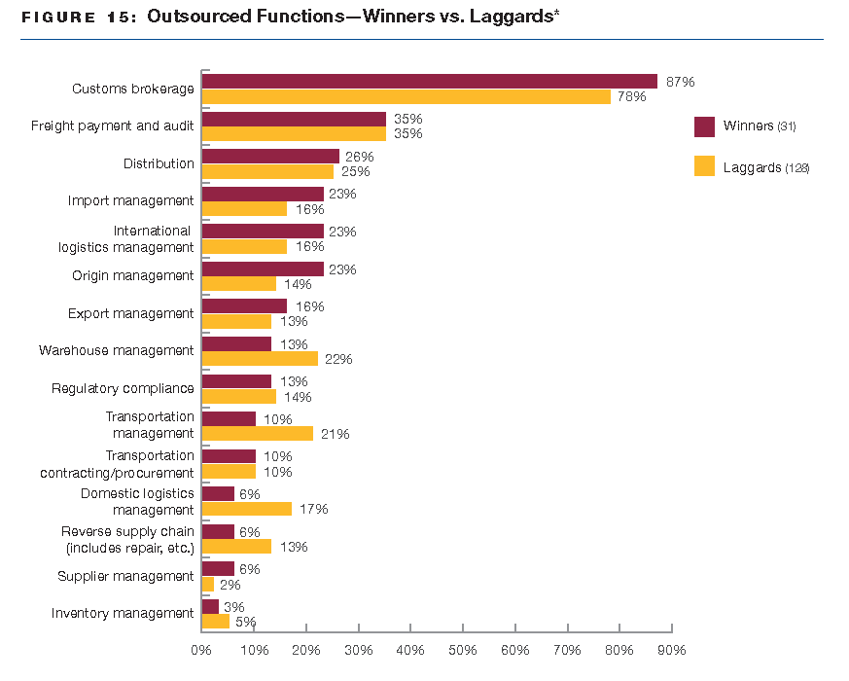
Outsourcing Trends
Best Practices / Benchmarking
COMPANY
Best in class companies more likely to outsource functions related to global trade management
COMPANY outsources the majority of its GTM activities that require specialized knowledge
(ref. #5)
Action required by COMPANY to close the gaps?

Slide 5
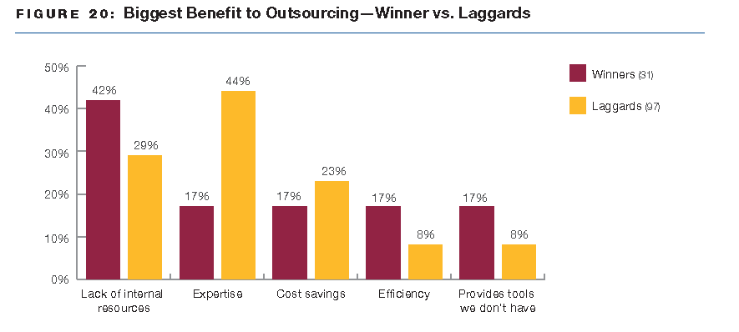
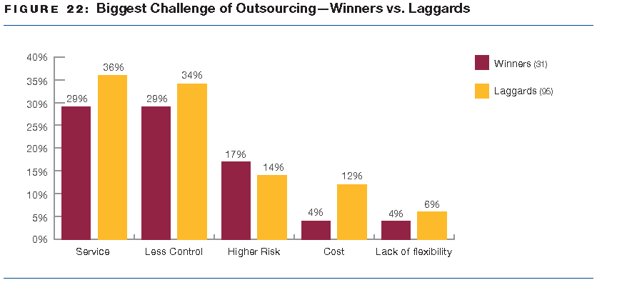
Outsourcing Benefits and Challenges
(ref. #5)
(ref. #5)

Slide 6
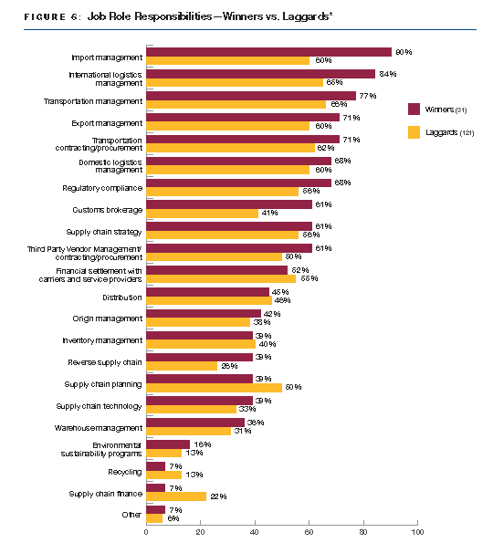
(ref. #5)
Winners are 25% more likely than laggards to have a global role
Winners entrust logistics staff with a broader scope of responsibilities
Action required by COMPANY to close the gaps?

Slide 7
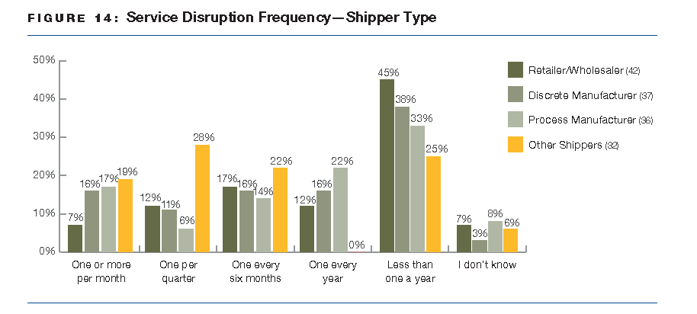
Opportunity for Improvement
Large shippers more likely to have more service disruptions; attributed to more complex supply chain with higher activity levels
Retailers experience lower levels of supply chain disruptions
Managed by supply chain managers
Early adopters of sophisticated supply chain principles and practices
Hold suppliers accountable via service level agreements; will penalize poor performing suppliers
(ref. #5)
Action required by COMPANY to close the gaps? Yes

Slide 8
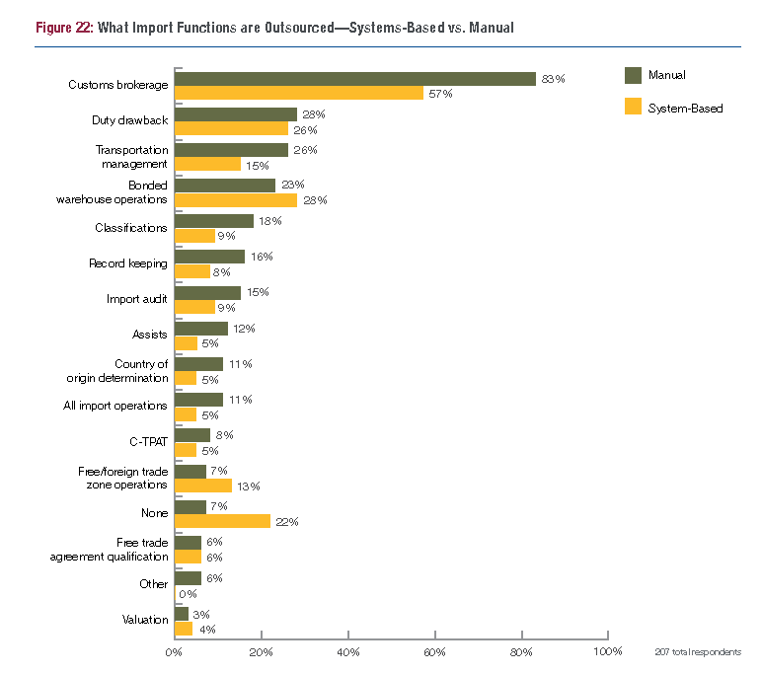
Imports into United States and Canada 2014
Importing has continued to become more complex. Best practices are a moving target. (ref. #1)
Best practice to have a systems-based approach for imports; allows for more flexibility in decision of whether to outsource (ref #2)
(ref. #1)
COMPANY
Action required by COMPANY to close the gaps? Yes
Notes:
Manual companies rely on outsourced functions at 2x the rate of systems based companies
COMPANY does not have SAP’s GTS module (global trade systems)
Current volumes, spend, risk – all factors for deciding whether to move to a system based import compliance platform

Slide 9

Compliance
Best Practices / Benchmarking
COMPANY
Regularly audit filings to customs
Root cause identification and resolution
Classification performed internally by importer of record, as opposed to customs broker
Record keeping and retention owned by importer of record in order to ensure the meeting of regulatory requirements
Sample auditing; BP >95%
Classification by Star
USA
Record keeping and retention by Star USA
Action required by COMPANY to close the gaps? No

Slide 10
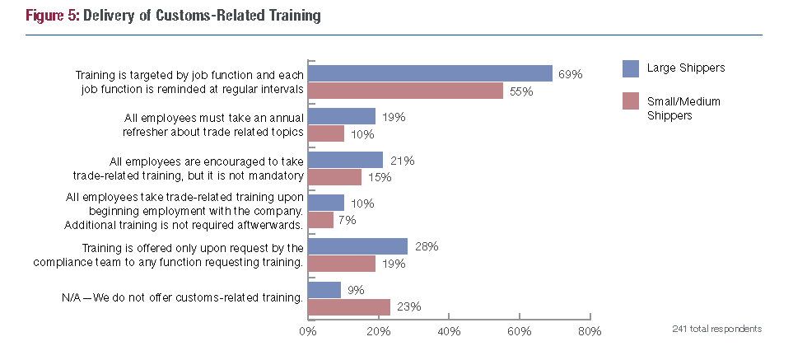
Training
Best Practices / Benchmarking
COMPANY
Mandatory customs education training (ref. #1)
Training performed at request or to resolve issues
(ref. #1)
Action required by COMPANY to close the gaps? Yes

Slide 11
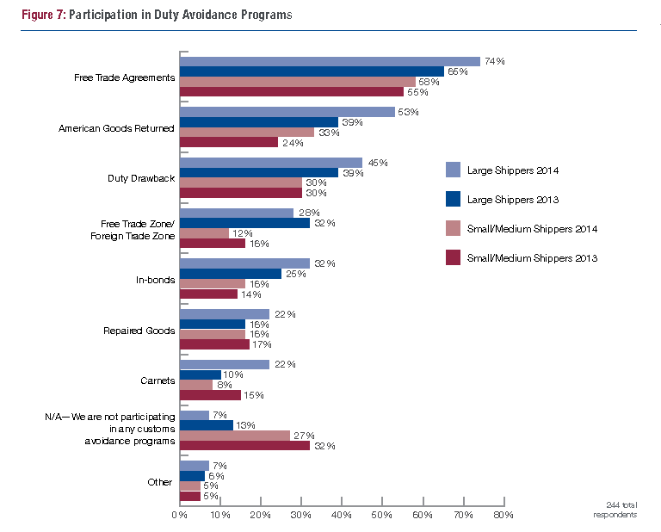
Duty Avoidance Programs
Best Practices / Benchmarking
COMPANY
Participation in duty avoidance programs; retaining all applicable records and declarations (ref. #1)
Participates in applicable duty avoidance programs with strong record retention practices
(ref. #1)
Action required by COMPANY to close the gaps? No

Slide 12
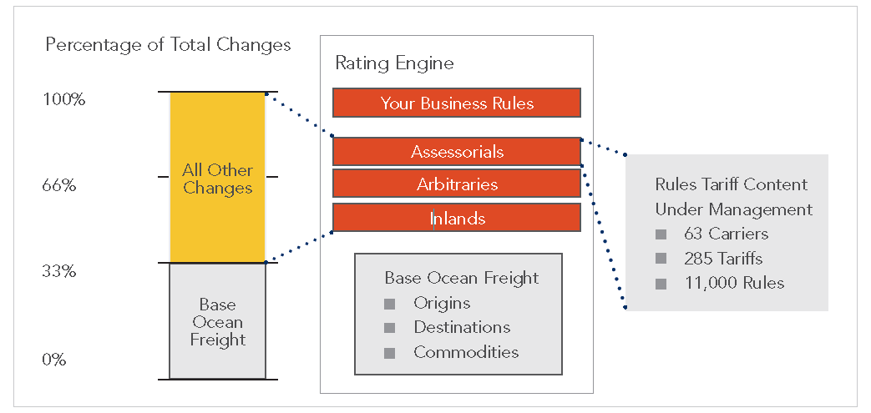
GTM Freight Payment
COMPANY
Best Practices / Benchmarking
Corporate logistics manages all suppliers & provides all freight quotes
Rate shells with standard lanes and preferred carriers
Corporate logistics audits and approves all GTM invoices
Manual pay process
Centrally manage contracts and offer “total rate searches”
Optimize carrier selection prior to booking
Audit and correctly pay freight bills of lading
Automate payment process; tolerances and metrics
(ref. #3)
Action required by COMPANY to close the gaps? Yes

Slide 13
References
“Import Operations and Compliance Benchmark Study: Chasing a Moving Target”, American Shipper, July 2014
“2014 American Shipper GTM Landscape Report: Sharpening Trade Compliance through Improved Automation and Data Quality”, American Shipper, Feb 2014
“Best Practices to Reduce International Freight Costs: A Guide for Global Logistics Managers”, Amber Road featuring research from Aberdeen, Feb 2014
“Global Transportation Management Benchmark Study: Building the Business Case for Better Visibility”, American Shipper with CSCMP, May 2014
“The Role of the Global Logistics Manager”, American Shipper with CSCMP, September 2013

Slide 14
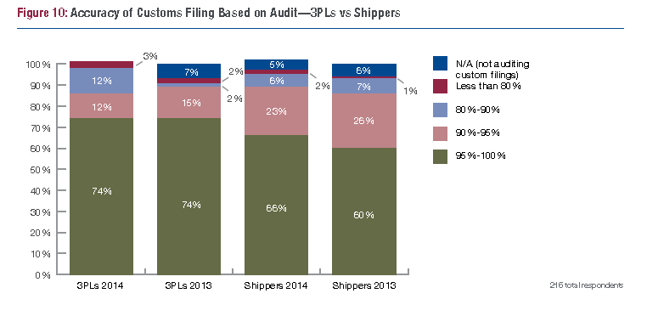
Appendix: Benchmarking of Auditing Accuracy
(ref. #1)

