Slide 1
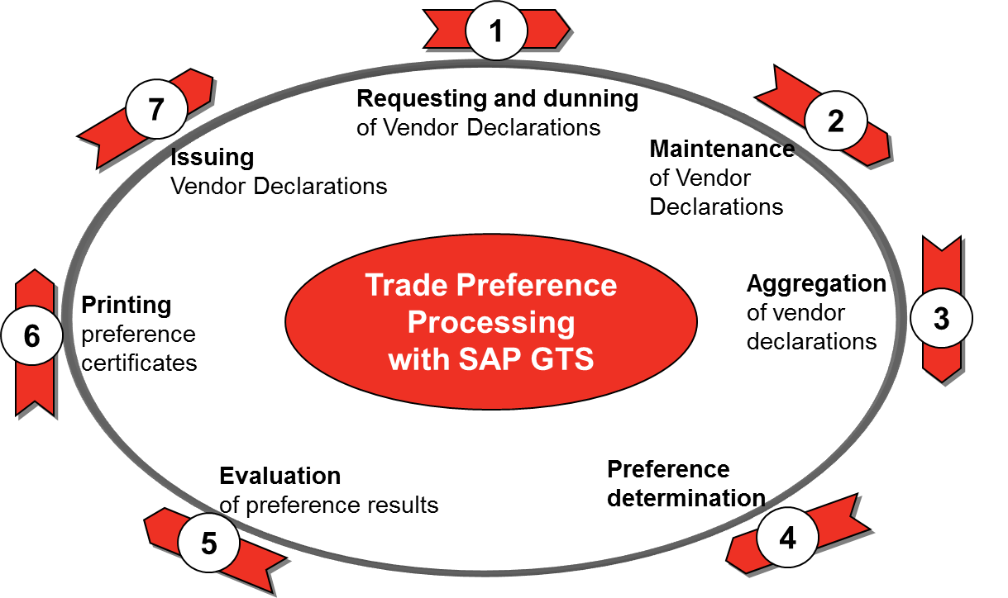
Classification & Qualification Process
Requirements and Issues
1.
Requirements:
WISPER - PUPD file – Part Supplier Data
ERP - CBM file – Costed BOM Data
Issues:
Data - Data integrity Supplier zip and country code poorly formatted or missing
Data - Supplier Email Address - Need to be maintained to execute solicitation process
Interface - Intercompany transfers (eg: Eaton Logistics Center) Not showing up as a supplier of a purchase that will be reflected in the Parts / Supplier Data file.
4.
Requirements:
WISPER - PUPD file – Part Supplier Data
ERP - CBM file – Costed BOM Data
Must have classification codes assigned to parts
Issues:
Data - Leading 0, leading spaces, trailing spaces – Temporary solution deployed
Interface - Items being reflected as purchased but contains a structure as a make item. – Interim solution deployed in PI/GTS . Must be fixed in the ERP interface with a permanent solution
Interface/Data - Missing lines in BOM
Interface/Data - Missing cost in BOM
Interface/Data - Level 0 cost not matching ERP cost calculation
Interface/Data - Receiving component data which shouldn’t be transferred from ERP. Causes wrong BOM Calculation (EX. Components for purchased items) Temporary solution deployed
6.
Requirements:
ERP - CPN File - Customer cross-reference part numbers
Customer data
Issues:
Data/Predecessor - If there are missing customer cross-reference part numbers in the system, GTS will create the certificate of origin with EATON parts. Most customers require certificate of origin with their part number codes. (Ex. Navistar does not accept Certificate of Origin with EATON parts)
Customer information is needed to issue a valid NAFTA certificate of origin.
Customer Requests Certificate of Origin

Slide 2
Current Planned Process
One plant at a time
Classification
Part/Supplier file (PUPD) loads to GTS. This creates the vendor in the GTS partner master (Note: If the vendor is intercompany, no supplier link is included in the ERP file. This has no impact on part classification, but will affect qualification of the product later in the process.)
BOM file is loaded to GTS - Data is ready to be classified for a specific plant.
Extract from GTS will load all parts into GTD (Global Trade Desktop) for classification.
CoE to provide spreadsheet data of all classified parts for this plant to Customs Info.
Customs info can do a one-time load for each set of classified parts (from spreadsheet data) to GTD.
Classification team is now able to classify all products that were not classified by one-time load.
Completed classifications will flow back into GTS on a regular schedule.
Qualification
Qualification team can run the process to generate LTVDs for all vendors/products loaded. This will generate emails to be sent to the vendor to solicit the country of origin information for their products. (Note: LTVD emails can’t be sent out to vendors without email addresses in the vendor records. These email addresses are currently not being loaded in the PUPD load.)
Customer part number file is loaded to GTS.
UPS Solicitation file loads to GTS for this plant. (This allows the long term vendor declaration to be updated with the solicitation results from UPS.)
Qualification team will manually maintain any LTVD’s that remain.
Qualification team will aggregate the data in the product master.
Run preference determination to qualify the goods for NAFTA.
Evaluate results and determine if there are still parts to be classified.
Send results to classification team.
Run custom transaction to print certificates of origin for customers.
Issue vendor declarations to customers.

