Slide 1


Organization of American States
Inter-American Committee on Ports
3rd Hemispheric Conference on Port Security
Punta Cana
Dominican Republic
April 8, 2008

Slide 2

CBP’s Mission….
Preventing the entry of terrorists and their weapons while facilitating legitimate trade and travel

Slide 3
It is a Challenging Task
1,900 miles of border with Mexico
5,000 miles of border with Canada
326 “ports of entry”—official entry or crossing points
142 Border Patrol stations
On a Typical Day….CBP Processes:
1,200,000 passengers and pedestrians
69,390 truck, rail and sea containers

Slide 4
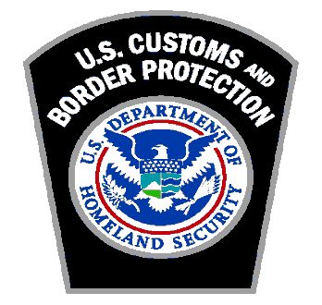
Layered Enforcement Strategy
Advance electronic information analysis and targeting of high risk shipments
  The 24-Hour Rule and the National Targeting Center (NTC)
Using advanced inspection technologies
  Non-intrusive Inspection Technologies (NII)
Pre-screening high-risk shipments prior to arrival in the U.S.
  Container Security Initiative (CSI)
  Secure Freight Initiative / 100% Scanning
Partnering with the trade community to increase supply chain security
  Customs-Trade Partnership Against Terrorism (C-TPAT)

Slide 5



The World Customs Organization
Framework of Standards to Secure and Facilitate Global Trade

Slide 6
What is the WCO Framework?
Global standards for supply chain security
Unanimously adopted by the World Customs Organization (WCO) in June 2005
150 WCO Members have signed Letters of Intent
Based on best practices in WCO Member customs administrations

Slide 7

22 of 34 OAS Members Signed
Argentina
Bahamas
Bolivia
Brazil
Canada
Chile
Costa Rica
Dominican Republic
Ecuador
El Salvador
Guatemala
Haiti
Honduras
Jamaica
Mexico
Nicaragua
Panama
Paraguay
St. Lucia
Trinidad and Tobago
U.S.
Uruguay

Slide 8
WCO’s Framework of Standards
FOUR CORE PRINCIPLES
Advanced electronic information
Risk management
Outbound inspection
Business
TWO PILLARS
Customs-to-Customs Pillar
Customs-to-Business Pillar

Slide 9
Supply Chain Security Program and the
WCO Framework
World Customs Organization lays out framework of standards to secure and facilitate global trade
Framework Based on 2 Pillars
  Customs-to-Customs Network Arrangements
  Customs-to-Business Partnerships
Supply Chain Security Program falls under the Customs-to-Business Pillar
  Main focus is creation of an international system for identifying private businesses that offer a high degree of security guarantees in respect to their role in the supply chain

Slide 10

Benefits of SAFE
Nations:
  Security and facilitation of trade
  Economic growth and development
  Improved revenue collection
  Economic and social protection
  Support of foreign investment
Customs:
  Exchange of accurate electronic information in a timely manner
  Improved control of imports and exports
  Better allocation of resources
  Customs reform and integrity improvement

Slide 11
Customs-Trade Partnership Against Terrorism
What is C-TPAT?
  CBP and Industry Leaders working together to enhance national security and facilitate legitimate cargo.
  Strengthening the international supply chain through the exchange of ideas, knowledge, and “best practices”.
  Builds upon existing Customs Industry Partnership Programs (IPP).
      Carrier Initiative Program (CIP)
      Americas Counter Smuggling Initiative (ACSI)

Slide 12
C-TPAT
C-TPAT is the largest government-private sector partnership to emerge from the terrorist attacks on September 11, 2001.
C-TPAT was launched in November 2001 with seven major importers who also saw the need for the focus on supply chain security.
The guiding principles for C-TPAT have been enhanced supply chain security, partnership, and a voluntary program.

Slide 13


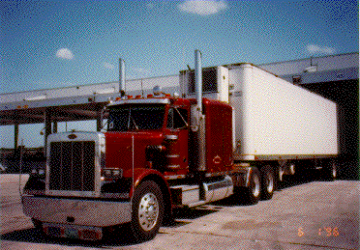
Who is Eligible to Participate?
U.S. Importers of Record
Carriers (Highway, Rail, Sea, Air)
U.S. Marine Port Authority/Terminal Operators
U.S. Air Freight Consolidators
Ocean Transportation Intermediaries and Non-Vessel Operating Common Carriers (NVOCC)
Mexican and Canadian Manufacturers
Licensed U.S. Customs Brokers

Slide 14
C-TPAT Security Criteria
Security Criteria for importers
Business Partner Requirements
  Documentation that they are a C-TPAT member
  Non-C-TPAT member, written or electronic confirmation meeting C-TPAT
  security criteria
  Container Security
  Written sealing procedures (PAS ISO 17712 seal)
  Seven-point inspection prior to loading / upon receipt
  Container Storage, secure locations, preventing of unauthorized entry into
  container or storage area
  Physical Access Controls
  Visitor procedures (including deliveries and mail) – Logbooks, visitor
  badges, escorted access
  Employment Procedures – Identification system

Slide 15
C-TPAT Security Criteria
  Personnel Security
  Procedures must be in place to screen prospective employees and to
  periodically check current personnel (Background, employment history)
  Personnel termination procedures must be in place to remove access
  Procedural Security –
  Document processing – accurate, complete & safeguarded
  Manifesting procedures – accurate and timely
  Security Training and Awareness
  A threat and security awareness program should be established for all employees
  Employees must be made aware of the procedures the company has in place to address a situation and how to report it

Slide 16
C-TPAT Security Criteria
  Physical Security
  Cargo handling and storage facilities must have physical barriers that guard against unauthorized access
  Information Technology Security
  Anti-virus software/ Firewalls
  IT security policies, procedures and standards must be in place and provided to employees in the form of training

Slide 17

C-TPAT Achievements
April 2, 2008
8,265 Certified Partners:
5 Field Offices; 156 staffing goal had been reached in December 2006
  Houston and Buffalo field offices being established. 50 additional personnel to be added in 2008.
7,359 Total Validations Completed
  6,465 Initial Validations Completed
  679 Re-Validations Completed
522 total suspensions/removals (256 Highway Carriers)
Security Criteria Implemented:
  Importers, Sea Carriers, Highway Carriers. Rail Carriers, Foreign Manufacturers, Customs Brokers, Mexico Long Haul Highway Carrier and Port Authorities/Terminal Operators, Air Carriers

Slide 18
Safe Port Act
  Recognizes the critical role of CBP in securing our nation’s border against terrorism by securing the supply chain and facilitating legitimate trade.
  SAFE Act Requires CBP:
    Certify new applicants within 90 days
    Validate all partners within one year of certification
    Revalidations not less than once every four year
    Third party validation pilot program

Slide 19
C-TPAT Benefits
Securing the Homeland
As part of contingency planning, C-TPAT partners will be the first to participate in the restoration of trade
Reduced Examinations
Front of line treatment
Assigned Supply Chain Security Specialist
Access to other programs (Free And Secure Trade (FAST), Importer Self Assessment (ISA)
Supply Chain Security Conferences hosted by C-TPAT yearly

Slide 20

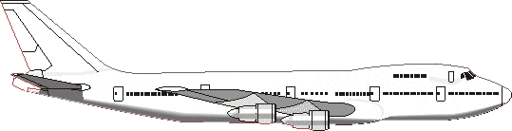

Mutual Recognition
C-TPAT and a foreign customs administration jointly recognize the security provisions of each other’s business partnership programs.
Origin
Transportation
Destination
Partnership Program
Partnership Program or C-TPAT
C-TPAT

Slide 21
Mutual Recognition
C-TPAT is currently working with…
  New Zealand Customs Service (Secure Export Scheme)
  Jordan Customs Department (Golden List)
  Singapore Customs (Secure Trade Partnership)
  European Union (Authorized Economic Operator)
  Australian Customs Service (Authorized Economic Operator)
  Canada Border Service Agency (Partners in Protection)

Slide 22
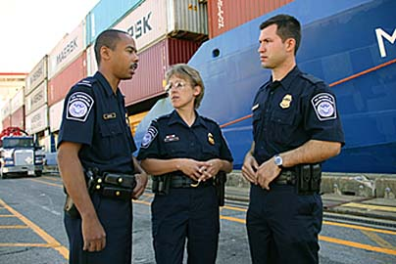
www.cbp.gov
Carlos E. Ochoa
Program Manager, C-TPAT
CBP Headquarters, Washington D.C.
(202) 344-2078
Notes:
.

