Slide 1
U.S. Customs and Border Protection
AM-100 Courtesy Notice of Liquidation Report Webinar
Monica Crockett Director, Entry Summary, Accounts and Revenue (ESAR)
Anita Brown ACE Business Office
  October 12, 2011

Slide 2

Overview of the AM-100 Report
The AM-100 Courtesy Notice of Liquidation report replaces the mailing of the courtesy notices of liquidation (CF4333A) to importers for entry summaries filed electronically.
Importers of record filing a paper formal entry with CBP will continue to receive a mailed courtesy notice.
Extensions and suspensions will continue to be printed and mailed to the appropriate parties.

Slide 3
Overview of AM-100 Report cont’d
The AM-100 report does not include entry types 11 and 12.
The AM-100 report will return results for the next two weeks liquidation cycle and will display the active or current liquidation information for the entry summary.
Liquidation updates will occur nightly. The standard report will only display changes in the next two week cycle. If a new liquidation was processed that falls in the next two week cycle it would appear in the report. If the liquidation was unset or had an update that changed the liquidation date to something other than the next two week cycle, it would disappear from the report.

Slide 4
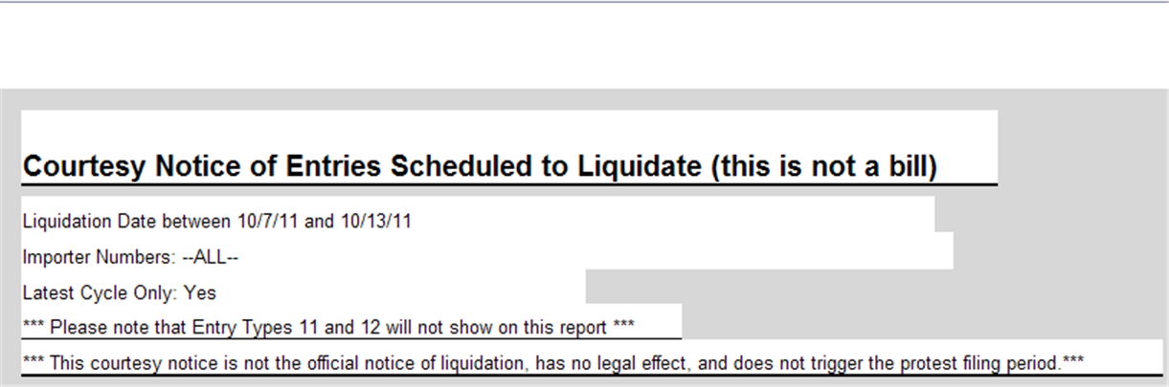
Overview of AM-100 Report cont’d
Disclaimer

Slide 5
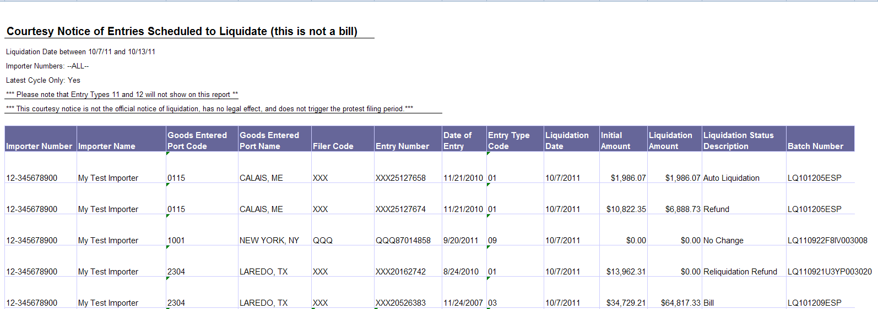
AM-100 Standard Report

Slide 6
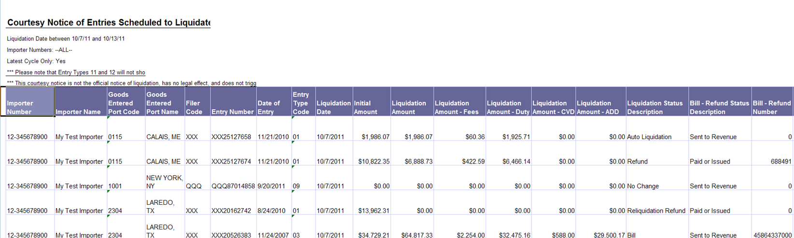
AM-100 Modified Report
Report modified to include fee breakouts and Bill-Refund Status Description and Bill-Refund Number

Slide 7
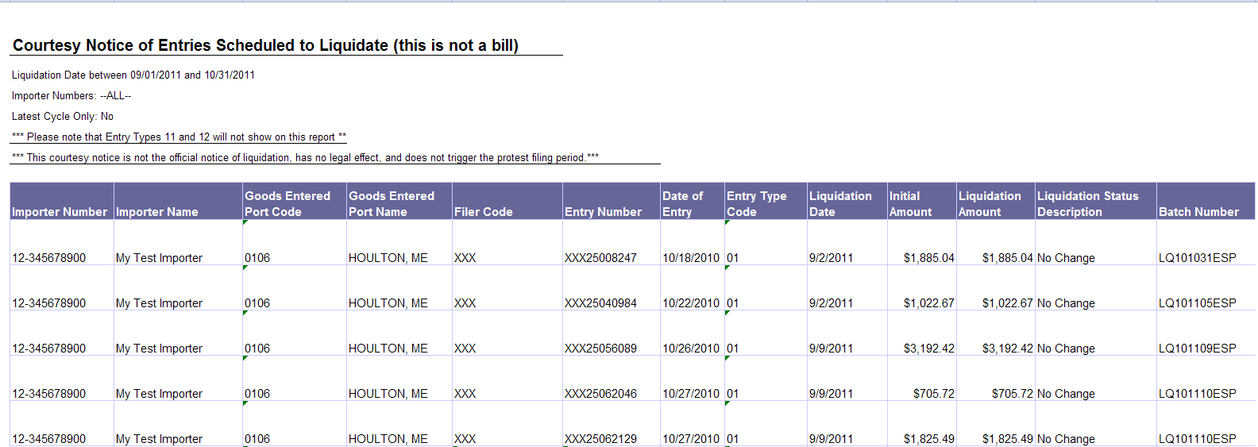
AM-100 Latest Cycle - No

Slide 8
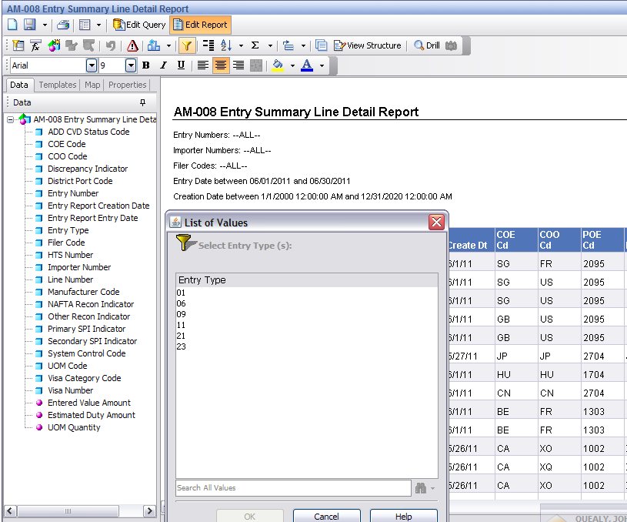
Modifying AM-008 Report
Entry types in
standard report.
Entry Types in
Standard Report

Slide 9
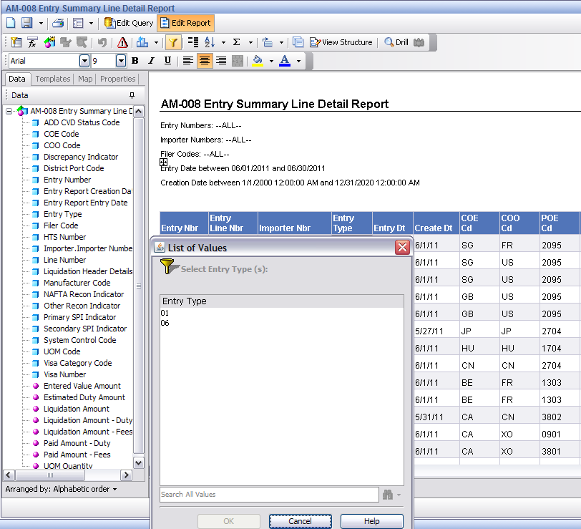
Modifying AM-008 Report cont’d
Entry types in report
once data objects are
added from the
Liquidation Header
Details sub-folder

Slide 10
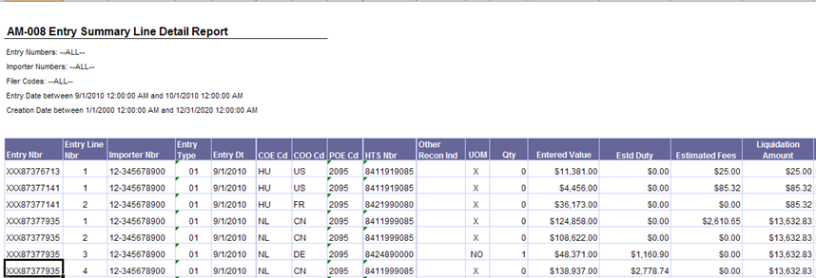
Modifying AM-008 Report
Please note when pulling any metric (data
objects with pink dot) from the
Liquidation Header Details sub-folder into
Entry Summary reports, the values will
display for each line item.
Example of overstatement

Slide 11
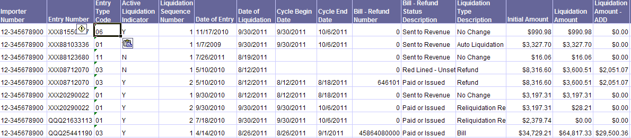
Liquidation History Report
  Users will need to create their own liquidation report to view the history of liquidations associated with an entry summary.
  Users should add the Active Liquidation Indicator and the Liquidation Sequence Number to the report.
  The highest Liquidation Sequence Number will indicate the most recent liquidation information.

Slide 12
Liquidation History Report cont’d
If the entry summary has been processed for liquidation and then re-liquidated, the Active Liquidation Indicator will read “Y” for both actions.
If you do not see the history of the liquidation but see a Liquidation Sequence Number greater than 1, you will need to change your date range to view the complete history.

Slide 13
Liquidation Header Details Sub-folder
Tips when using the Liquidation Header Details sub-folder:
  The AM-008, AM-068, ESM-7008 and ESM-7068 reports can be customized using data objects from the Liquidation Header Details sub-folder.
  When modifying AM 008 with any object from the Liquidation Header Details sub-folder, users must also add the Importer Name or Importer Number from the Liquidation Header Details sub-folder to receive results.
  Values from the Liquidation Header Details sub-folder will appear as whole dollars when added to the AM-008, AM-068, ESM-7008 or ESM-7068 reports. Users will need to format the columns to currency.
  The way the Entry Report and Liquidation Header Details tables are combined, when a user brings any data object from the Liquidation Header Details sub-folder into the report (for example AM 008) the results will change to reflect only entry summaries for which a courtesy notice would have been mailed.

Slide 14
Liquidation Header Details Sub-folder
Tips when using the Liquidation Header Details sub-folder:
  When modifying AM-068 or ESM-7068 with metrics (data objects with pink dots) from the Liquidation Header Details sub-folder, the resulting values may show an over-statement of values if there are multiple line items for the entry summary. These resulting values show the sum of the number of lines on the entry summary. For example if the Liquidation Amount is $5,000 and there are 50 lines on the entry summary, the report will display $250,000 for the liquidation amount.
  When modify AM-008 or ESM-7008 with metrics (data objects with pink dots) from the Liquidation Header Details sub-folder such as liquidated amounts or liquidation fee breakouts, those values will appear with each line item on the report for the entry summary. To avoid over-stated values, users should NOT sum metrics added from the Liquidation Header Details sub-folder.

Slide 15
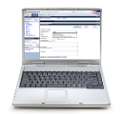



Additional Resources
Portal Applications
The application to request your free ACE Portal account as well as instructions and tutorials can be found on CBP.gov
http://www.cbp.gov/xp/cgov/trade/automated/modernization/ace_app_info/
Web Based Training for each release
https://nemo.customs.gov/ace_online
Cargo Systems Messaging Service
A subscription based, broadcast message system for users of CBP automated commercial trade system http://apps.cbp.gov/csms/
www.CBP.gov/Modernization
ACE Fact Sheets | Training and Reference Guides
Federal Register Notices | Presentations of Capabilities
Notes:
15

Slide 16
Questions?
Notes:
16

