Slide 1
Leveraging Zone Programs Around the World 2015 ICPA Bangkok / Shanghai 09 November / 12 November 2015 Clay Perry SVP-Global Markets Integration Point

Slide 2
Integration Point Network
North America
Atlanta
Charlotte
Chicago
Washington
Edmonton
El Paso
Rochester
Latin America Mexico City
Monterrey
Reynosa
São Paulo
Torreon
Europe
Brussels
Tbilisi
Asia
Kuala Lumpur
Shanghai
Singapore
Vadodara
Australia
Melbourne
Africa
Cape Town

Slide 3
Objectives
Compare the similarities and differences between zone programs around the world
Recommend approach to establish a common compliance structure for managing zones around the world
Primary zone programs reviewed
U.S. Foreign-Trade Zone (FTZ)
Mexico Maquiladora (IMMEX)
Europe Processing under Customs Control (PCC)
Brazil Tolling / Drawback
Thailand Board of Investment (BOI)
China Processing Trade Regimes (PTR / eHandbook)

Slide 4
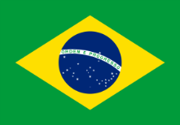
Disclaimer and Acknowledgements
I am not a certified expert in all of the zone programs I am about to discuss, but I have also never met anyone that is
This presentation was put together through the assistance of Integration Point leaders from the respective region
Regional acknowledgements…
Homero Farias
Wei Mun Tan
Manfred Mong
Michiko Lloyd
Claudio Marques

Slide 5
Agenda
Zone Overview by Type
Baseline – US Foreign-Trade Zone
Zone Program Comparison
Other Zones Programs
Common Zone Approach

Slide 6
Zones by Type

Slide 7
Duty Deferral by Type
Free Zone
Export Processing Zone
Import/Inward Processing Zone
Inverted Duty
Drawback
Combinations of the Above

Slide 8
Baseline – US FTZ

Slide 9
FTZ Purpose
The Foreign-Trade Zone (FTZ) program was created by the U.S. government to facilitate international trade and increase the “global competitiveness” of U.S.-based companies.
The program, created in the 1930s, continues to thrive and change to better meet the needs of American companies in the global economy.
FTZ’s are used by Department of Commerce to establish savings that incent corporations to establish or maintain operations in the US thus…
Creating and Maintaining Local Jobs!!!

Slide 10
What is an FTZ?
An FTZ is an area within the United States, in or near a U.S. Customs port of entry, where foreign and domestic merchandise is considered to be outside the country, or at least, outside of U.S. Customs territory.
Certain types of merchandise can be imported into a Zone without going through formal Customs entry procedures or paying import duties.
Customs duties and excise taxes are due only at the time of transfer from the FTZ for U.S. consumption.
If the merchandise never enters the U.S. commerce (exported or destroyed), then no duties or taxes are paid on those items.

Slide 11
FTZ Processing Overview
Foreign
Supplier
US Customer
US Port
Receipts
Shipments
Move In Bond
No duty paid
Does not move
in bond
FTZ
Admit on
E214 Foreign
Status
Ship to US
Cust on CF7501
Duty Paid
Duty Paid does
Not move in bond
FTZ
Admit into
Zone in Domestic
Status No Form
Ship to FTZ on CF7512 No
Duty Pay
Move In
Bond No
duty paid
FTZ
Move In Bond
No duty paid
Admit on
E214 Foreign
Status
Ship to Foreign
Cust on CF7512
No Duty Paid
US Supplier
Move In Bond
No duty paid
Admit into
Zone in Domestic
Status no Form
Scrap (CF216)
No Duty Paid
US Port
Does not
move in bond
+ Adjustments
Admit on e214
Adjustments
(CF7501) Duty
Paid
Foreign
Customer

Slide 12
US FTZ Benefit Summary
Duty Deferral – Paying duty later
Duty Avoidance – Never paying duty
1. Exports
2. Scrap
Duty Inversion – Paying lower duty on manufactured goods
Other Savings / Distributor Benefits
1. MPF Savings
2. Broker Fee Savings
3. Direct Delivery (Reduced Lead Times)

Slide 13
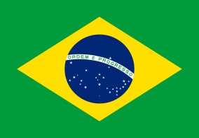
Zones Program Comparison

Slide 14
Types and Forms
United States | Mexico | Europe | Brazil | Thailand | China
Foreign-Trade Zone (Subzone / General Purpose Zone) Bonded Warehouse | IMMEX (Maquiladora) Deposito Fiscal (Automotive, Fiscalizado and Regular Deposito Fiscal) | Customs Warehousing Out/Inward Processing Proc. Under Customs Ctrl. | Drawback Suspension Integrado (Tolling) | Free Trade Zones Board of Investment (BOI) | Economic Zones EPZ,IBZ,FTZ,BLP Processing Trade (PTR) Bonded Warehouse
CF214 – FTZ Admission (Inbound) CF7501-06 –Weekly Entry (Domestic Outbound) CF7512 – Bonded Withdrawal (Outbound Export) | Pedimento (Per individual import/export operation) Pedimento Consolidado (Weekly or Monthly) COVE (Electronic invoicing to VUCEM) | Single Admin. Document (SAD) - Imp/Exp Supplementary Declaration Import (SDI) - Simplified Proc. Supplementary Declaration Warehouse (SDW) - Export | Drawback Authorization Shipment Authorization + Nota Fiscal + Import Declaration Export Declaration | BOI Authorization Shipment Authorization + Import Declaration Export Declaration | Import Clearance Sheet + Application Export Clearance Sheet + Application Bonded Material Domestic Sales Application
Types
Main Forms

Slide 15
Timing, Allocation, and Recon
United States | Mexico | Europe | Brazil | Thailand | China
Inbound - Daily after warehouse arrival Outbound (Dom) - Weekly summary of all withdrawals Outbound (Exp) - Daily at time of withdrawal | Regular Pedimento: Time of crossing Consolidated Pedimento: Weekly or Monthly | SAD: Time of procedure SDI: 4th day following month in which the goods released SDW: 4th day following month of entry into the records | Drawback Authorization (Periodic Approval) Shipment Auth. (At Port) Import Declaration (At warehouse) | All clearances done in advance of warehouse Exports in advance with BOM analysis | All clearances need to be done before warehouse can receive goods* *Special post declaration reporting is hard to obtain
First In / First Out (FIFO) Lot Allocation Petroleum Producibility | Primero Entrada / Primero Salida (PEPS) PEPS by Lot Allocation | First In / First Out (FIFO) As agreed through authorisation | Primero Entrada / Primero Salida (PEPS) Project-based | Part Number Identification (FIFO or Specific Identification) | FIFO (logical/ multi-cycle) Batch/Lot Allocation
Annual Reconciliation Report to CBP | Selection Basis (Use of GLOSA comparison) | As agreed through authorisation | Tolling Based (Remain within Authorization) | As agreed through BOI authorization | 6 month Handbook Reconciliation
Timing
Allocation
Recon

Slide 16
Savings, Fees, and Time Limits
United States | Mexico | Europe | Brazil | Thailand | China
Duty Deferral Duty Avoidance Duty Inversion MPF/Broker Savings Personal Property Tax | Duty Deferral Duty Avoidance VAT Elimination for Temporary Imports | Duty Deferral Lower or zero duty rate after processing | Duty Deferral Duty Avoidance Duty Inversion Regional Tax Exemptions | Duty Deferral Duty Inversion (Raw Materials) No Duty on Machinery Income Tax Reduction | Duty Deferral Duty Avoidance VAT Exemption
Merchandise Processing Fee Harbor Maintenance | Insurance and Processing Fees Only | Guarantees (UK flexible) VAT | IPI PIS COFINS ICMS | Documentation Fees PGA Fees | Documentation Merchandise Processing Fee
No Time Limit | 18 Months (Non-certified) 36 Months (Certified) | 6 months to 1 year depending on authorisation | Drawback Authorization Period | Per BOI Authorization | Per Authorization
Savings
Fees
Time

Slide 17
e-Filing, Special Notes, and Reference Sites
United States | Mexico | Europe | Brazil | Thailand | China
ACS/ACE via ABI (Admissions and Withdrawals) | SAAI (Import/Export Pedimento) VUCEM (COVE filings) | GB = CHIEF NL=Sagitta/AGS DE = ATLAS FR – DELTA BE – PLDA IT - AIDA | SISCOMEX - Sistema de Comercio Exterior | Long Term Solution Being Evaluated | H2000 (E-Handbook & Declarations)
PF vs. NPF Status allows lowest duty rate No duty on items destroyed in the zone | Track and Defer Duty on Fixed Assets/Equip. Cert. Maquilas have reduced processing times and border reviews | Retrospection (within 1 year) For some countries like UK, duty is paid on scrap | Special regional tax benefits may be obtained Cannot exceed authorized tolling amounts | Allow Skilled Workers from Abroad Permit to Own Land Currency Flexibility | Statistical BOM Allocation Many Types of Handbooks B/C/E/K/J/W/H Lack of Uniformity
http://ia.ita.doc.gov/ ftzpage/ | www.aduanas.sat.gob.mx/ | http://ec.europa.eu/taxation_customs/customs/procedural_aspects/imports/index_en.htm | www.desenvolvimento.gov.br. | www.boi.go.th | http://english.customs.gov.cn/tabid/47800/Default.aspx
Filing
Special
Ref.

Slide 18
Other Zones Programs

Slide 19
Other Regional Examples
Russia
16 Federal Economic Zones
FEZs are regulated by Federal Law # 116 FZ on July 22, 2005
South Korea
6 Free Economic Zones
Korean FEZs are designated by law to facilitate foreign investment
Kenya
40 Export Processing Zone (EPZ) in place with 40,000 workers and 10.7% of exports
To transform the economy from import substitution to a path of export led growth
Philippines
200+ Economic Zones (ecozones)
Collections of industries, brought together geographically for the purpose of promoting economic development

Slide 20
One Platform Approach

Slide 21
Common Approach to Zones
Common Inventory Allocation Methods
First In First Out (FIFO)
Lot / Serial Number
Foreign First
Common Transaction Requirements
Inbound Receipts
Outbound Shipments
Adjustments / Scrap
Manufacturing (BOM or Actual)

Slide 22
Common Approach to Zones
Common Data Elements
Product Number (SKU)
Classification / FTA Indicator
Status Code (Foreign or Domestic)
Duty Rates
Quantity (Internal UOM and Customs UOM)
Weight
Value / Currency Code / Exchange Rate
Country of Origin / Country Ship To
Manufacturer / Supplier ID
Bill of Lading & Manifest Information

Slide 23
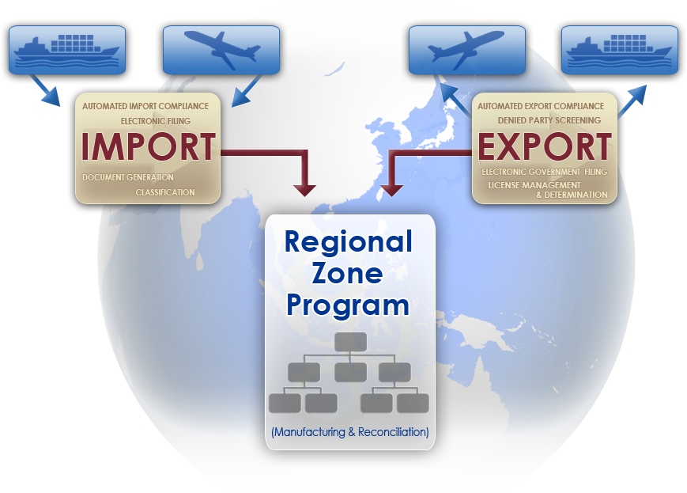
One Platform Approach

Slide 24
Thank You
Thank You Gracias Merci Obrigado 谢谢 (Xièxiè) ขอขอบคุณ (Khob khun krab) Mr. Clay Perry Clay.Perry@IntegrationPoint.com +1 704 576 3678 ext. 1132

