Slide 1
China Customs & Trade Benchmarking and Experience Sharing on Voluntary Disclosure
www.pwccn.com
12 Nov 2015

Slide 2
Agenda
Introduction
PwC Customs & Trade Benchmarking Survey
Shanghai Customs Circular [2014] No.32 - Voluntary Disclosure

Slide 3
Introduction
1

Slide 4
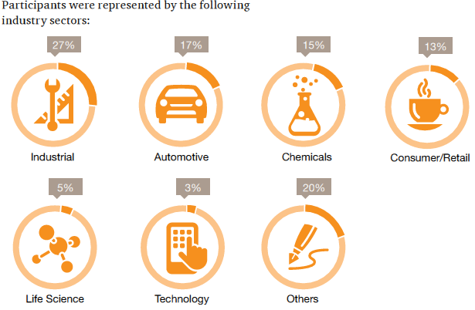
Introduction
Participants
42% of companies have manufacturing operations. 26% of companies have Import/Export Trading operations. 32% of companies operate both of them.
Participants came from the following industries:
Data Source
From over 500 companies who joined PwC Q1 workshop “Innovation in China Customs and International Trade in 2015” around China during Jan and Feb 2015.

Slide 5
Introduction
Less than 5 years
Between 5-10 years
More than 10 years
Participants reported the following levels of experience in customs and international trade:
28%
34%
38%
Participants reported to the following functional teams within their organisations:

Slide 6
Benchmarking your priorities in 2015
Cost Saving
25% will use Free Trade Agreement
25% will reduce customs clearance lead time
21% will reduce CIQ clearance time
19% will use bonded zones
10% will use bonded manufacturing / bonded repair
Compliance Management
32% will conduct compliance self-assessments/ health-checks
25% will deliver training to relevant management/ staffs
20% will implement new procedures and processes
15% will strengthen relationships with Customs/CIQ
8% will secure written rulings from Customs
Technology and Automation
44% will implement e-Clearance ( paperless declaration )
25% will deploy Global Trade Management (GTM) such as SAP-GTS, AmberRoad, IntegrationPolint, etc.
19% will implement EDI self-filling of Import/Export Declaration
12% have no automation plan in 2015

Slide 7
Tariff Measures
2

Slide 8
Who determines the HS Code of your products?
Tariff Measures
Importers/exporters are required to make a complete and accurate declaration, including the Harmonised System (HS) code. The HS code determines duty rates, general import/export prohibitions & quantitative restrictions, regulatory and licensing requirements, commodity inspection, and the like. The Customs authority is actively reviewing importers/exporters – either at the time of goods declaration or post-importation during audit – to ensure that the correct HS code is declared.

Slide 9
Have you experienced different interpretations of the HS code by Customs depending on the Port of entry/exit?
Tariff Measures
Based on prior year Survey’s several companies are working with pre-approved intermediary agencies to complete ‘pre-classification’ in order to attain compliance and mitigate the risk of delays in goods clearance. In the future so-called ‘pre-classification opinions’ may become effective nation-wide so that greater consistency is experienced across multiple Ports of entry/exit.
20%
No
10%
Don’t Know/
Not applicable
Yes
70%

Slide 10
Customs Valuation
Has your company successfully worked with Customs and implemented a retrospective Transfer Pricing Adjustment (TPA)?
For inter-company transactions, when does your company proactively notify Customs of an import price adjustment, either upwards or downwards?

Slide 11
Country of Origin
China has worked extensively over the past 10 years or so to establish a network of regional and bilateral Free Trade Agreements (FTA). This network is set to expand significantly in the short to medium term with the Australia and South Korea FTA expected to ‘go live’.
Use of FTA to legitimately save customs duty costs and improve market access and competiveness is a top priority for several companies.

Slide 12
Which of the following practical challenges has your company experienced when utilizing FTA(s)?
Country of Origin
Customs reserve the right to challenge the legitimacy of an FTA claim as lodged by the Importer. Checks typically take place upon arrival and declaration of the imported goods and they are made by the in-charge Port Customs.
Based on PwC experience the Rules of Origin and facts and circumstances of the specific importation have to be evaluated in order to work towards a sustainable FTA solution with Customs.

Slide 13
Non-tariff Measures
3

Slide 14
Non-tariff Measures
Non-tariff measures (NTMs) are represented by other requirements imposed at the border such as sanitary or environmental protection measures, technical barriers to trade, quotas, exports restrictions, and the like.
Non-tariff measures should be established based on scientific principles and uphold consumer health and safety.
Occasionally, certain measures standards can appear as unreasonable and protectionist in nature in which case resolution can be sought via the WTO.
In China, Commodity Inspection and Quarantine (CIQ) is the lead agency enforcing NTM at the border. Prior year Surveys have shown that the China Compulsory Certificate (CCC) and import licensing are the two most common types of NTM applicable to imported goods. Managing NTM is a fundamental consideration when developing a best-practice trade compliance strategy.

Slide 15
Non-tariff Measures
What is the average CIQ clearance lead time?
What is the average CIQ inspection rate of your main products?

Slide 16
Non-tariff Measures
What is the current CIQ Credit Ranking of your company?
AQSIQ has been rolling out a risk-based ‘credit ranking’ approach in order to enhance the supervision and control over companies. Qualification for Rank AA can help to improve efficiency in the import supply chain.
Rank B
20%
31%
Rank A
42%
Don’t Know
Has your company benefited from the new “Three Ones” Policy (one declaration – one inspection – one release)?
7%
0% Rank C
0% Rank D
Rank AA
Companies are encouraged to participate in these pilot programs in order to reduce time and save cost when declaring and clearing goods into China.

Slide 17
Customs Audit and Investigation
4

Slide 18
Customs Audit and Investigation
In 2014, was your company audited by Customs for any of the following?
Post importation audit is best-practice for Customs authorities around the world and China has adopted this approach for over 15 years. Criminal investigations may also be initiated when the Importer is suspected to have acted with intent to evade the supervision and control of Customs.
33%
13%
Tariff Classification
Dutiable value
48%
Handbook
4%
Other
2%
Country of Origin
If challenged on the dutiable value (customs valuation), which area was audited by Customs?

Slide 19
If challenged on the declared dutiable value, did Customs ask your company to provide Transfer Pricing Documentation (TPD)?
Customs Audit and Investigation
Year-on-year we see an increasing number of companies sharing a copy of the TPD with Customs in order to resolve an audit on arm’s length pricing.
TPD is prepared for income tax purposes based on OECD transfer pricing standards. The approach for demonstrating an arm’s length transfer price for Customs purposes is quite different.
For Customs purposes, we still see companies using the Deductive Method to test for an arm’s length import pricing at a product specific level.

Slide 20
Did the outcome of the audit/investigation result in an additional customs duty/import VAT assessment?
Customs Audit and Investigation
Did the outcome of the audit/ investigation result in financial penalty?
45%
Yes, claw-back duty/VAT
14%
Case is still open
Yes, penalties
80%
41%
No
8%
12%
Case is still open
No

Slide 21
How long did it take to resolve the Customs audit/investigation?
Customs Audit and Investigation
Less than 3 months
3 to 6 months
More than 6 months
31%
40%
29%

Slide 22
Bonded Manufacturing Operations
5

Slide 23
Bonded Manufacturing Operations
83%
Bonded manufacturing operations or Processing Trade (PT) refers to a special regime that was introduced to encourage manufacturing for export.
PT is the major duty relief scheme for import export-orientated manufacturers to adopt.
Customs’ still use the Handbook as the primarily tool for supervision and control of companies engaged in PT.
Use of an E-account is best-practice.
17%
83% of companies indicated that they are engaged in buy-sell contract manufacturing whilst the remaining 17% reported toll manufacturing with a processing fee charged. This result is consistent with prior year Surveys

Slide 24
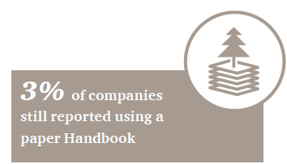
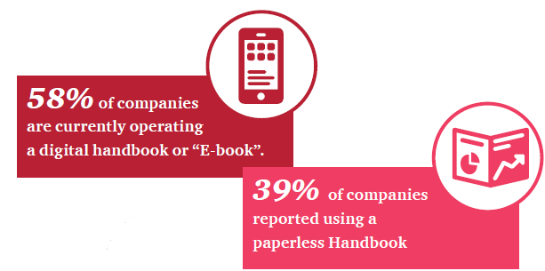
Bonded Manufacturing Operations

Slide 25
If your Handbook is audited by Customs tomorrow, do you think it would balance?
Bonded Manufacturing Operations
An efficient and effective bonded management control system is crucial for companies to enhance compliance with the relevant supervision control requirements and to mitigate noncompliance risks.
This result is an improvement on prior year Surveys. The top reasons for Handbook imbalance are generally regarded to still consist of:
• Difficulty in updating the Bill of Materials (BoM) in a timely manner
• Waste, scrap and defect disposal
• Cross-over of bonded and non-bonded materials

Slide 26
Bonded Manufacturing Operations
Customs are seeking ways to further simplify reconciliation procedures for network supervision enterprises. For example, can the actual production BoM be extracted directly from the ERP system for Handbook reconciliation purposes? We will see.
Which of the following measure(s) has your company adopted (if any) to improve your Handbook management?
* (e.g. SAP-GTS, AmberRoad, Integration-Point etc.)

Slide 27
Trade Facilitation
6

Slide 28
Trade Facilitation
80% of companies are directly acting as the legal IoR/EoR. The reason for this is to tighten control (including foreign exchange remittance) and save service provider costs by moving certain functions in-house. Most companies are ranked as “Certified Enterprises” or “Advanced Certified Enterprises”. This indicates that enterprises are realizing economic benefits as a result of having a high rating. The remaining companies are planning to upgrade their enterprise ranking in 2015.
20% of companies are still engaging third party Import/Export Agents to act as the IoR/EoR; this solution is typically adopted by foreign companies that are new to China and/or who face significant NTM.

Slide 29
What is the average import clearance time?

Slide 30
Trade Facilitation
How many gateway ports do you use for imports into China?
Only 1 port
49%
More than 3 ports
35%
16%
2-3 ports
What action did you take in 2014 to improve trade facilitation?

Slide 31
How many Customs Brokers are you typically using?
Trade Facilitation
Foreign invested enterprises that are well established in China tend to use a Customs Broker to support in completing the declaration and have their own legal entity acting as the IoR/EoR
Over 14 reform measures have been rolled out by Shanghai Customs as well as additional inspection and quarantine related measures by Shanghai CIQ.
Which new SPFTZ policy is most important to your business?

Slide 32
Shanghai Customs Circular [2014] No.32 - Voluntary Disclosure
7

Slide 33
Enterprise self-disclosure management
Ways to self-disclose:
Voluntary disclosure via corporate annual information report
Submission of enterprise self-discipline report to Customs
Timely and proactively report of non-compliance areas not covered in a Customs Audit Notice
Other written format that is accepted by Customs
Shanghai Customs Circular [2014] No.32
Self-disclosure areas (PFTZ only):
Non-compliance issues against Customs regulations encountered in daily operations
Non-compliance issues against Customs regulations beyond the scope of a typical Customs Audit
1
2
3
4
Voluntary audit
Self-audit report
Random check by Customs

Slide 34
Enterprise self-disclosure management (cont’d)
Primary risk areas
Potential benefits
Bonded manufacturing: Handbook balance, registration accuracy, BOM /UoC update, cross-over, outsourcing, scrap/waste/defect disposal.
Customs valuation: Related party transactions, transfer pricing adjustments, royalty/license fee, warranty, non-trade remittances, etc.
Tariff classification: Duty, non-tariff measures, pre-classification, classification grouping, etc.
Duty exempted equipment: Disposal, 5-year customs supervision period, duty free quota.
Quantity: Under/over shipment discrepancies, mis-shipments due to errors by the shipper, etc.
Bonded goods: Inbound/outbound procedures, dutiable nature of bonded cost, etc.
Other issues: Goods description, origin, etc.
1
Lowered, mitigated or no administrative penalties
3
Overdue fines reduced or exempted
4
Exempted from customs routine audit in the next year
2
Prudent review on downgrading

Slide 35
Customs Enterprise Credit Management
AA
Advanced Certified Enterprises
A
General Certified Enterprises
B
General Credit Enterprises
C/D
Re-categorised by Customs
No more constraints on I/E volume or threshold for the establishment/operation time, so a newly established enterprise may directly apply for the Advanced Certified Enterprises

Slide 36
Customs Enterprise Credit Management (cont’d)
Publication of Enterprise Credit Information
Customs shall publish the credit information of enterprises. In particular, the period for publicity of administrative penalties imposed on enterprises by Customs is 5 years
3rd Party Validation
Customs or the applicant may entrust an authorised agency to perform the validation assessment, the result of which could be referred to by Customs for appraisal of the applicant’s credit standing
Mutual Recognition of AEO
Officially state that Certified Enterprises are the Authorised Economic Operators (AEO) in China.
Advanced Authorised Enterprises are entitled to trade facilitations programs offered by the contracting party under mutual recognition of AEO (i.e. Singapore, Korea and Hong Kong)
Adjustment to the Category
Dynamic monitoring and adjustments to the validation of enterprise credit standings. The validation for Advanced Authorised Enterprises shall be revisited every 3 years, while that for General Authorised Enterprises shall be revisited randomly
Where a discredited enterprise meets the criteria for a higher grading, Customs may adjust it to a General Credit Enterprise

Slide 37
Case Study
8

Slide 38
1. Inventory Management
HS Code
Customs Description
Customs Unit of Measure
Quantity on Documentation
Registered Customs Value
Customs System
Customs System Inventory Balance
ERP
SKU#
ERP Unit of Measure
Actual Quantity
Value Based on Accounting
Actual
Inventory Balance
Slide 38

Slide 39
1. Compliance Areas
Customs Compliance with Automation
Periodic & Accurate
Reconciliation
Product Grouping Rules
Over/Short Shipment & Stock Adjustment Management
Physical Inventory Management
Non-Bonded Goods Processing Management
Unit of Measure Management

Slide 40
Enterprise self-disclosure management
Leniency does not mean no thorough review by Customs
Understanding Customs’ practices and treatment for the specific case beforehand important
Preparation, strategy and approach still key to success

Slide 41
Summary
9

Slide 42
Summary
Whatever your goals are, we hope that this benchmarking survey report has provided you with an overall picture that can help you measure performance, develop strategies, and attain best practice in your cross-border operations.
Continue to create value within your own organization whist still retaining the highest levels of trade compliance.
Growing foreign trade and meeting the set targets are going to be high priorities for the General Administration of Customs. You can take advantage of new trade facilitation programs that are available in order to enhance your performance.

Slide 43
Thank you!
Derek Lee
Partner, Worldtrade Management Services Shanghai & Hong Kong
Tel: (86) 21 2323 7733
Email: derek.wc.lee@cn.pwc.com
© 2015 PricewaterhouseCoopers Worldtrade Management Service (Shanghai) Co., Ltd. All rights reserved. In this document, “PwC” refers to PricewaterhouseCoopers Worldtrade Management Service (Shanghai) Co., Ltd., which is a member firm of PricewaterhouseCoopers International Limited, each member firm of which is a separate legal entity. The information contained in this presentation is of a general nature only. It is not meant to be comprehensive and does not constitute the rendering of legal, tax or other professional advice or service by "PwC”. PwC has no obligation to update the information as law and practices change. The application and impact of laws can vary widely based on the specific facts involved. Before taking any action, please ensure that you obtain advice specific to your circumstances from your usual PwC client service team or your other advisers.
The materials contained in this presentation were assembled on 12 November 2015 and were based on the law enforceable and information available at that time.
43

