Slide 1
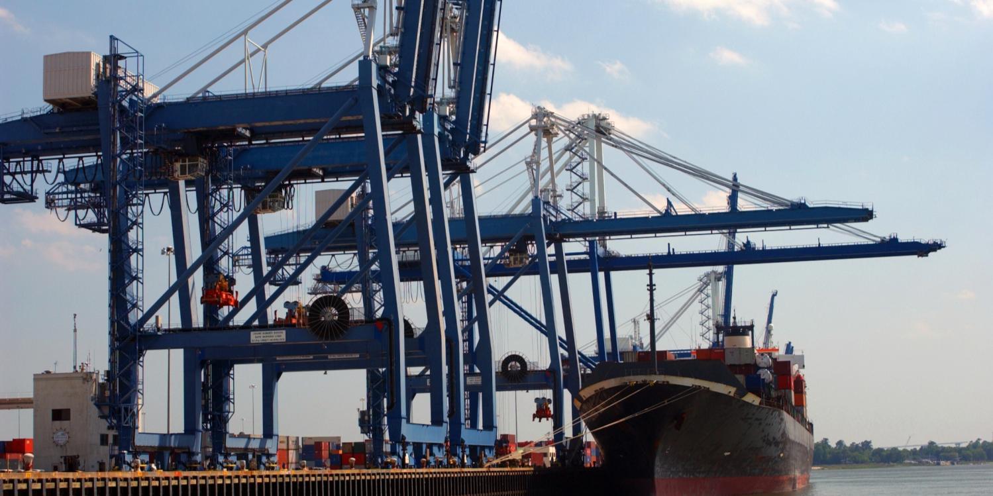
Audits Discussion
2015
ICPA Asia 2015
Bangkok and Shanghai

Slide 2
Audits
Summary
Definition
Overview of various audit types
Importance of audits
Broker internal audits
Importer / exporter internal audits
Government external audits
Audit alternatives / supplements
Closing comments
Notes:
We will to through the various types of audits but our goal is to explain the intrinsic importance of broker audits in keeping you, the importer/exporter, compliant

Slide 3
Audits
Definition
An official examination and verification of accounts and records . . . and procedures
Notes:
Standard dictionary definition
Accounts and records
Within the context of customs brokerage clearance activities
Also add procedures
Broker audits tie back to the responsibilities tied to authority given to them by local Customs in order to conduct customs brokerage transactions

Slide 4
Audit Types
Purpose of each type of audit
Broker audits
Validation of records and procedures to ensure continued compliance of the broker
Importer/exporter audits
Internal validation of records and procedures to ensure importers’ / exporters’ own compliance
Government audits
Audit importers’/exporters’ or brokers’ procedures to validate proper compliance
Emphasis on potential high risk scenarios
High levels of value
Regulated goods
Notes:
3 Standard Types of Audits
Broker
What they do and what they broker does for their customers
Ensuring to manage with responsible care and supervision
Direct reflection on how we’re managing our customers
Importer/Exporter
What you do for yourself in remaining compliant
Evaluation of the entry packets post entry
Importer audits the entry packet to the commercial documents submitted to customs
Part of due diligence
Maintain documentation for the required time period
Gov’t Audits
Customs – target audit the broker
Usually in response to something that triggered the gov’t to audit
High value
Regulated goods
Apparent irregular activity: post entry amendments, frequent examinations, quantity discrepancies, frequent free trade agreement; related parties, dumping/countervailing
OGA – specific to their procedures (health ministry is the most prevalent)
Proper certificates and licenses

Slide 5
Importance of audits
Key goals of broker audits
Alignment with Customs’ and other government agency requirements
Consistency / accuracy of documentation and entry submissions
Ability to detect problems, correct them and minimize those problems in the future
Help offset the “Post Entry Challenge”
Notes:
Alignment from importer/exporter to broker to Customs
Consistency
Objective to avoid rec’ving audits
Detect, fix and eliminate any problems in the process
Importer/Exporter’s environment is constantly changing
New products / new lanes / new regulations
Staying current with those changes

Slide 6
What exactly is “the Post Entry Challenge”?
Not all countries offer a standard post entry mechanism
Where no standard mechanism is available the importer may not be able to easily make an adjustment and risk a non-compliant shipment or an overpayment of duties and taxes
Submits entry
Recognizes error and re-submits for an adjustment
Adjustment can only be made via official (or not at all)
Customs
Broker
Customs
Officer
High Ranking
Customs
Official
Notes:
What happens when Customs has only exceptional mechanisms for providing corrections?
Only under “extenuating” circumstances will you be able to make an adjustment
Avoiding mistakes (that can’t be adjusted) much more critical in this sort of scenario

Slide 7
Risk of not being compliant
Consider these potential scenarios
Overpaying duties on misclassified goods
Underpaying duties on misclassified goods and risking a penalty
Not properly declaring country of origin
Risk of importing something restricted or paying wrong duty rate
Repeated mistakes of the above leading to a government audit
Notes:
These are the implications for not being compliant and with the Post Entry Challenge having these type of penalties “fester”

Slide 8
Purpose of a broker’s audit
Identify and evaluate key areas of the brokerage business that could involve potential risk / liability from a regulatory perspective to both broker and to client
Proper controls
Does an operation have the proper controls and processes in place to ensure marginal risk?
Documented procedures in place
Training completed for key personnel
Self audits scheduled
Key areas of compliance need
Approvals and Licenses (do we have the proper permits / licenses to conduct business)
Bonds and Guarantees in place
Notes:
Proper Controls
Procedures is “what to do”
Training is understanding “how to do it”
Audit is confirmation that procedures were followed
Key Areas
Fundamental components to be able to operate

Slide 9
The broker’s audit process
Evaluation of transactions for Customs
Classifications
Values
Quantity
Duty and tax
Producer / manufacturer
Documentation
Trade agreements
Evaluation of transactions for other government agencies
Proper licenses and permits
Notes:
Transaction Components
Each component is a key element of the customs clearance process with its own risk of non-compliance
Classifications – mis-classify – wrong product – overpay/underpay duties
Values – not paying attention to values from a related party
Duty and tax – applying based on the country of origin
Trade agreements – making sure the % of value is met
Documentation – all proper documentation including copies licenses or packing lists
Producer / manufacturer – potential implications of ADD
Quantity – assuring that there are controls in place to confirm what was on the paperwork
Other Government Agencies
Proper licenses and permits

Slide 10
Identification of key areas of risk
Fine and penalties
Record keeping
Customs examinations
Post entry processing
Management of transit volume
Where applicable
Volume that transits a location but doesn’t enter the customs territory
Proper bonding and securing as it transits
Notes:
Central part of the broker audit
Mistakes or oversights in any of these areas will indicate a potential risk of impending government audit

Slide 11
Importer/exporter audits
What importer does to remain compliant
Typically:
Evaluation of entry packets post entry
Audit the packet to documentation submitted to customs
Part of due diligence
Assure documentation is maintained for the required time period

Slide 12
Government audits
Example: China
Audit types
Normal inspection
Special inspection
Audit period
Up to 3 years after release
Exceptions
Audit Scope
Importer, exporter, bonded entity, broker, etc.
Records, payments, goods, licenses and permits
Liability – (pertaining to China)
Penalties, delays or loss of privileges
Notes:
Audit Types
- Normal Inspection: focus more on small and mid-size importer/exporter or broker, scheduled or random selections
- Special Inspection: high-risk enterprises or industry
Audit Period
- general import or export goods, up to 3 years after release
- bonded, special D&T exempted program and temp import/export goods, inclusive supervision period and afterward 3 years.
Audit Scope
Audit Importer or Exporter, Bonded Entity, Broker, etc. on below items
- accounting records
- CDF and related documents
- Related import & export goods.
- D&T payment
- License and permit
- Etc.
Liability – CN
Penalty on exporter/importer or possible penalty on direct exporter/importer supervision staff for following scenario but not limit to.
- incorrect data provided or hold back some facts, or
- reject/delay to provide records, documents, etc., or
- transfer, revise, destroy records or related docs.

Slide 13
What you can do?
Evaluate your broker
What audit methods employed
Audit yourself
Leverage internal compliance resources
Engage a trade management consultant or attorney
Look again at your “Post Entry Challenge”
How many and where (which countries) do you have this challenge?
Notes:
Evaluate
What they do to what’s recommended on the prior 3 slides
Audit yourself
Make sure that you have your process in place
Check how frequently you make mistakes
Post Entry Challenge
How frequently is there a problem for you?

Slide 14
Addressing the “Post Entry Challenge”
Managed services options
Push strategies
Shipper’s letter of instruction (SLI)
Pull strategies
Audit what will be submitted to gov’t pre entry, or when not possible, audit what was just submitted post entry
Feedback loop
“Push” SLI
“Pull” (Receive)
Submission Copies
Importer
Customs
Broker
Notes:
There are options to address the post entry challenge
They are complementary meaning that you can use one or more of them
The you use the tighter your process will be
You weigh cost of the added compliance to the risk and cost

Slide 15
Next steps
Evaluate your broker
Audit yourself
Address your “Post Entry Challenge”
Notes:
Go back and evaluate your broker
Evaluate yourself and your internal procedures
Determine the amount of risk pertaining to the Post Entry Challenge and respond accordingly

Slide 16
